Slide 1
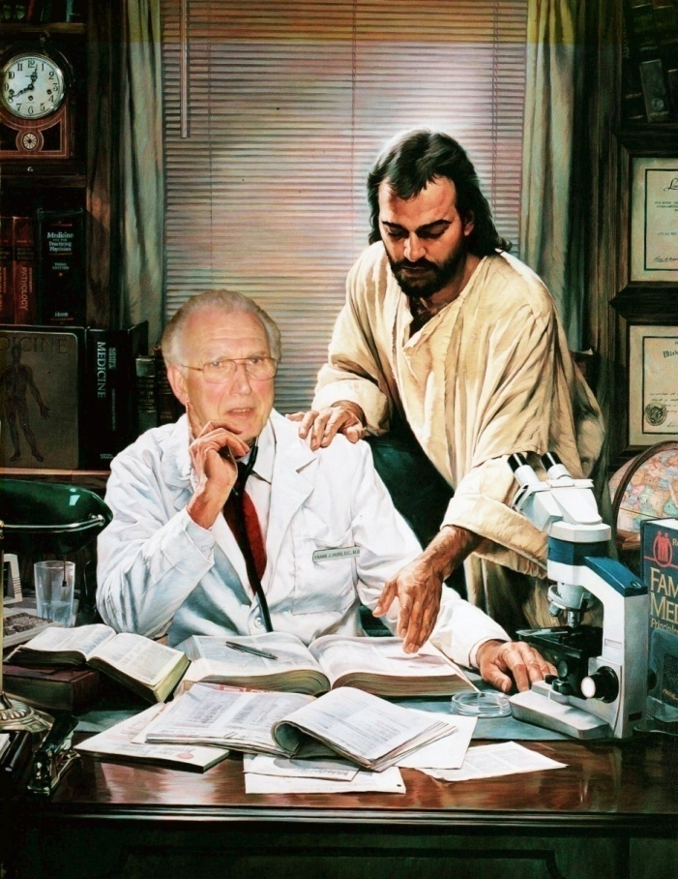
Remembering dad
by Melissa Derfler

Slide 2
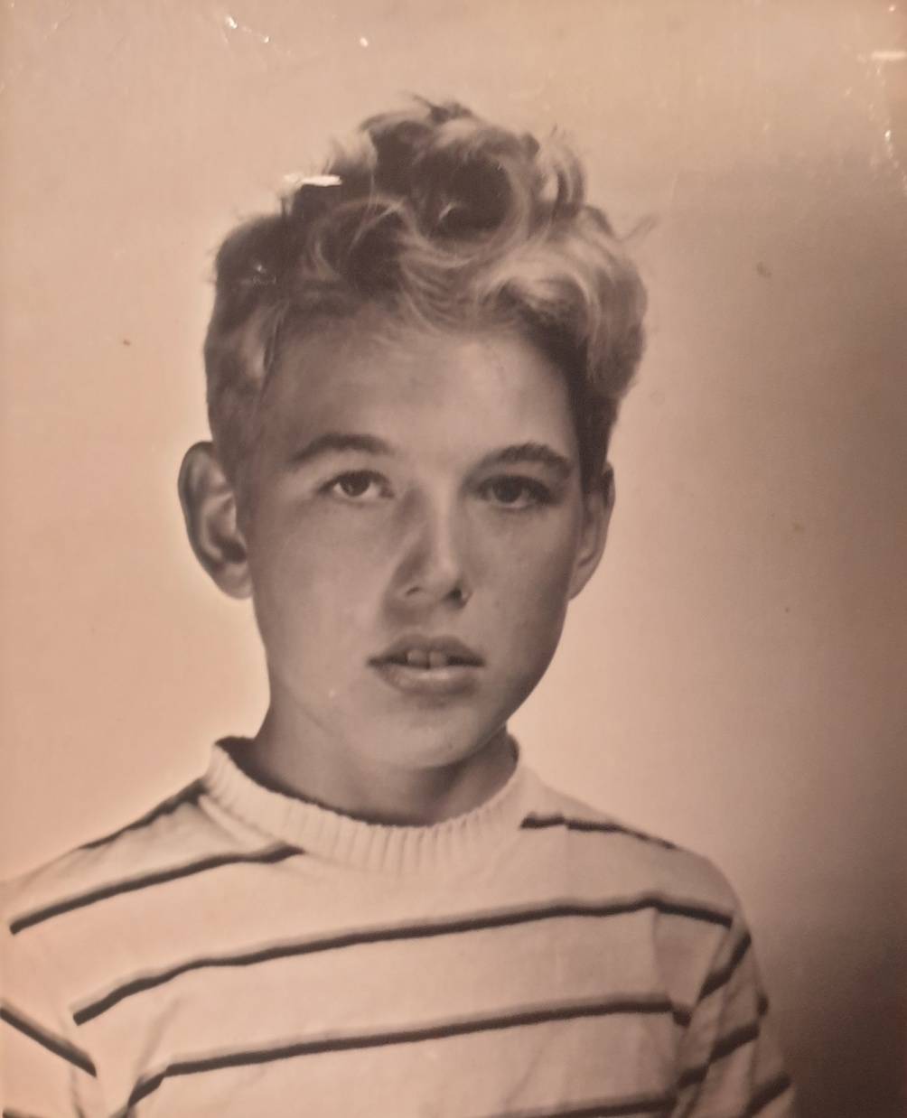
Earliest picture we have of Dad

Slide 3
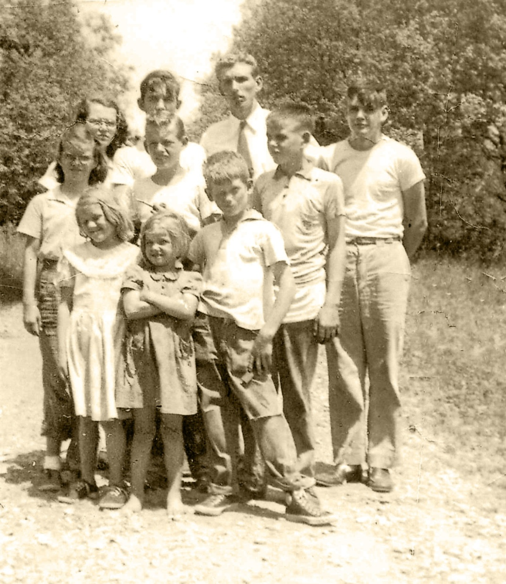
Dad and
his nine
siblings

Slide 4
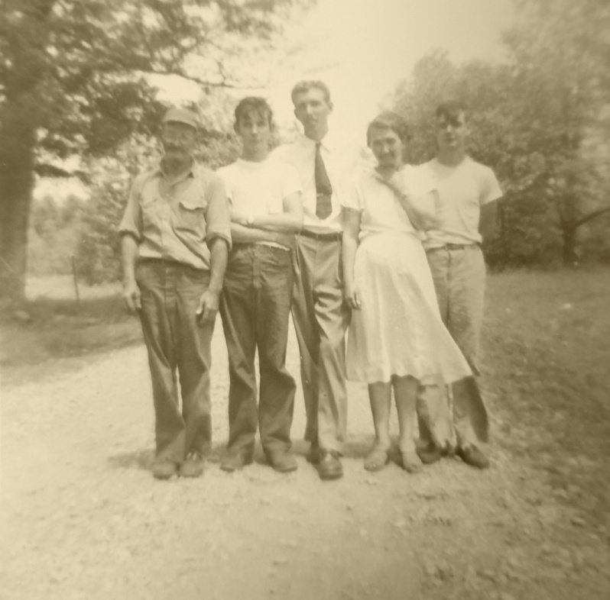
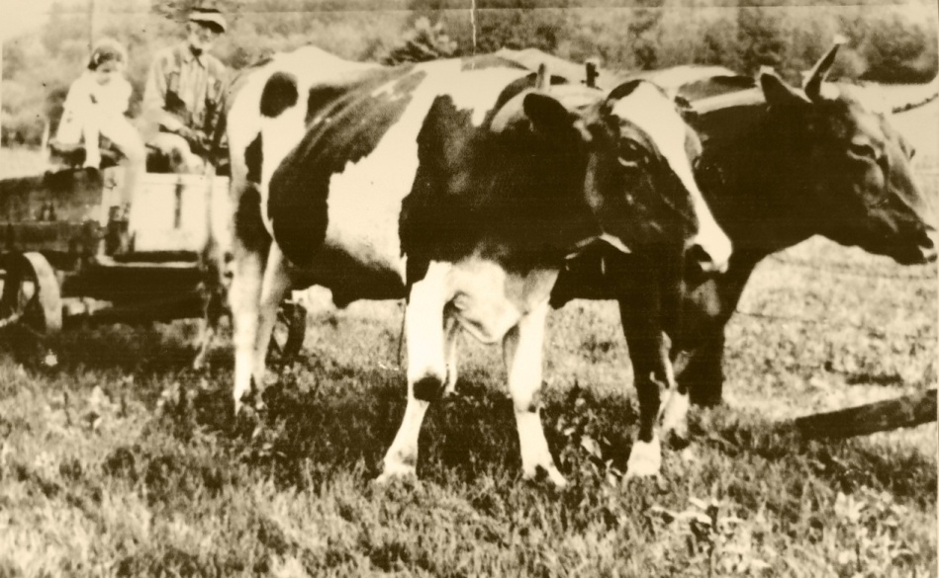
Dad with his parents and
two brothers
The oxen Dad’s
parents drove

Slide 5
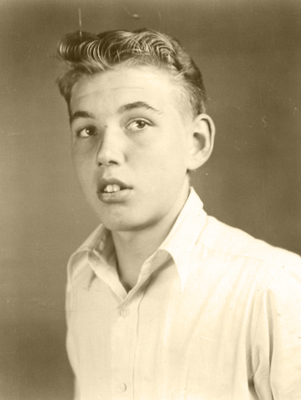
Dad about age 16

Slide 6
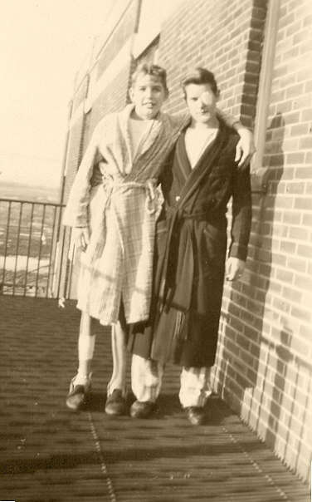
Dad in the hospital
after all his leg
fractures

Slide 7
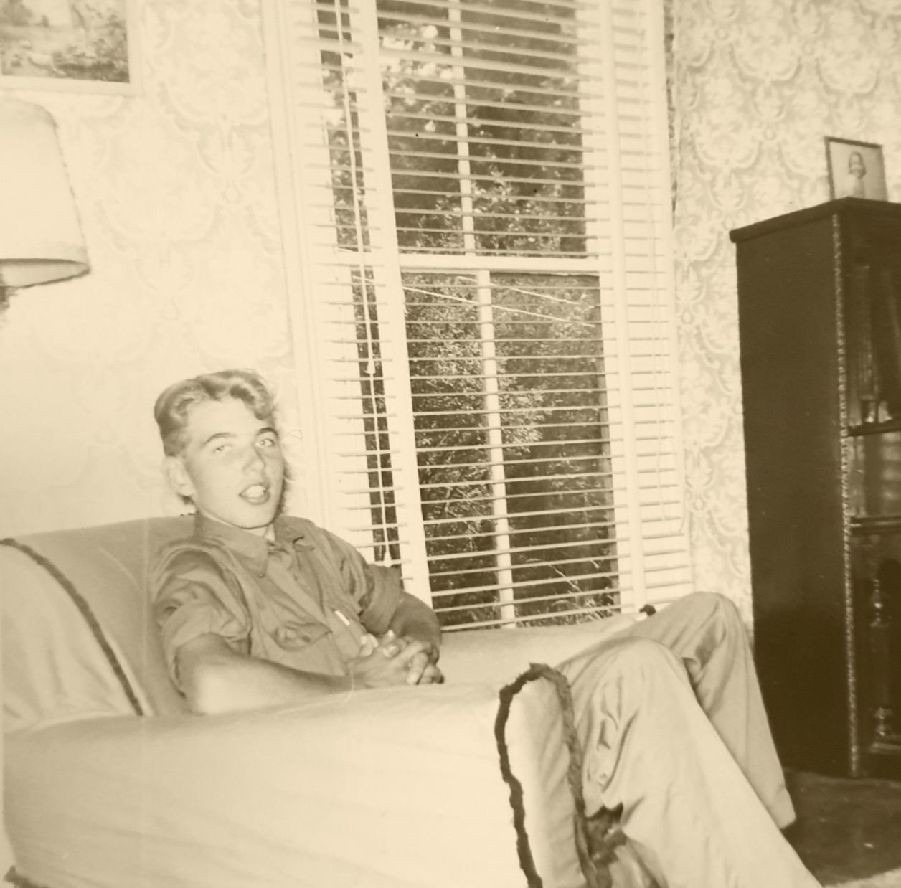

Slide 8
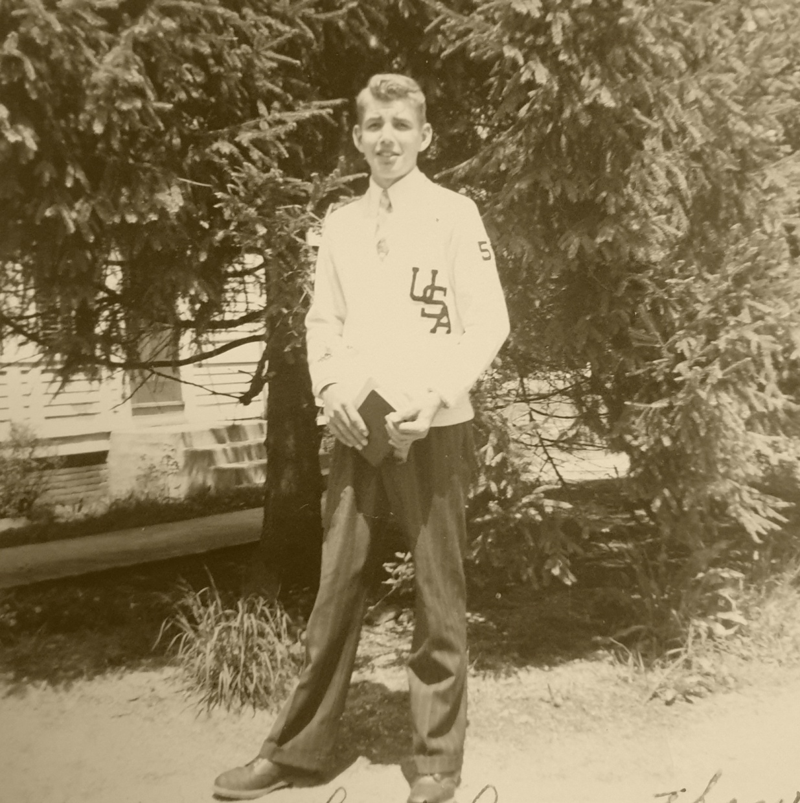

Slide 9
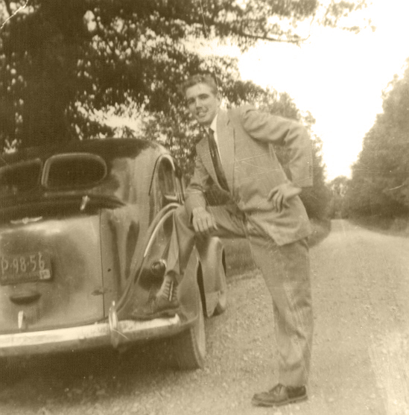

Slide 10
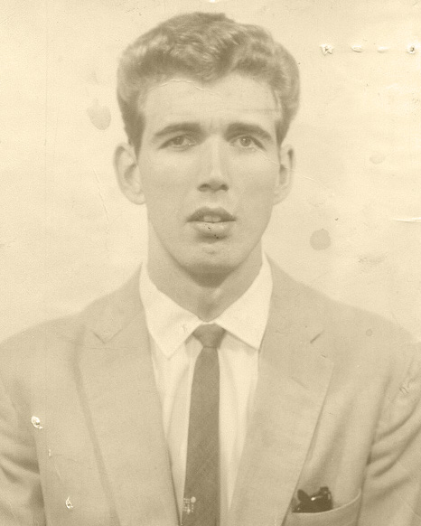
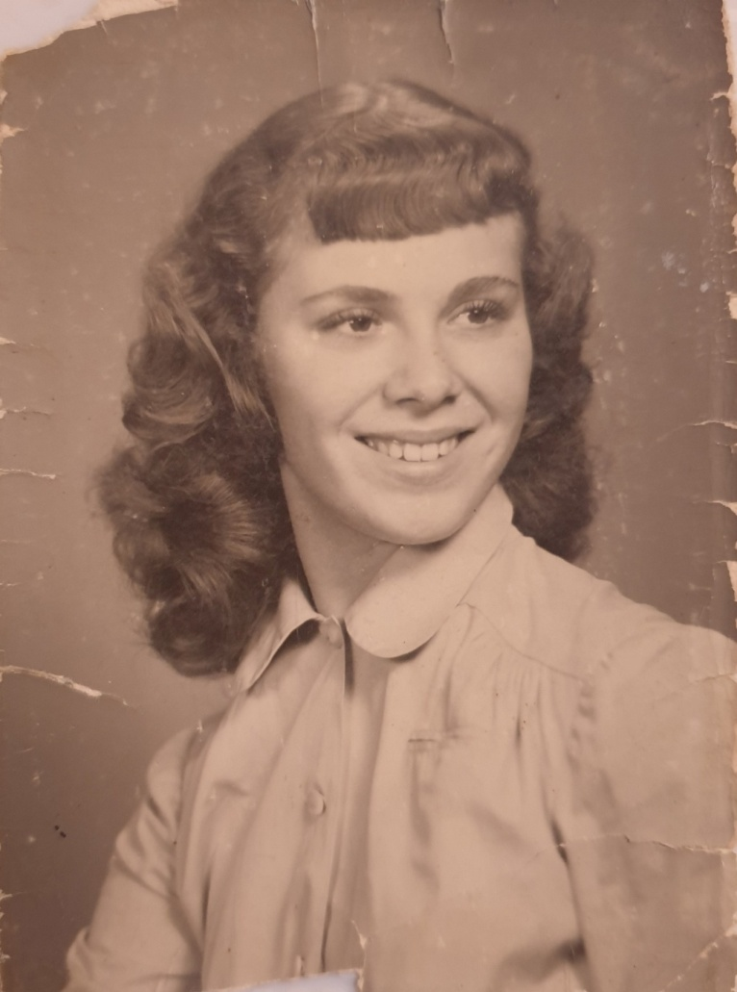
Dad and Mom

Slide 11
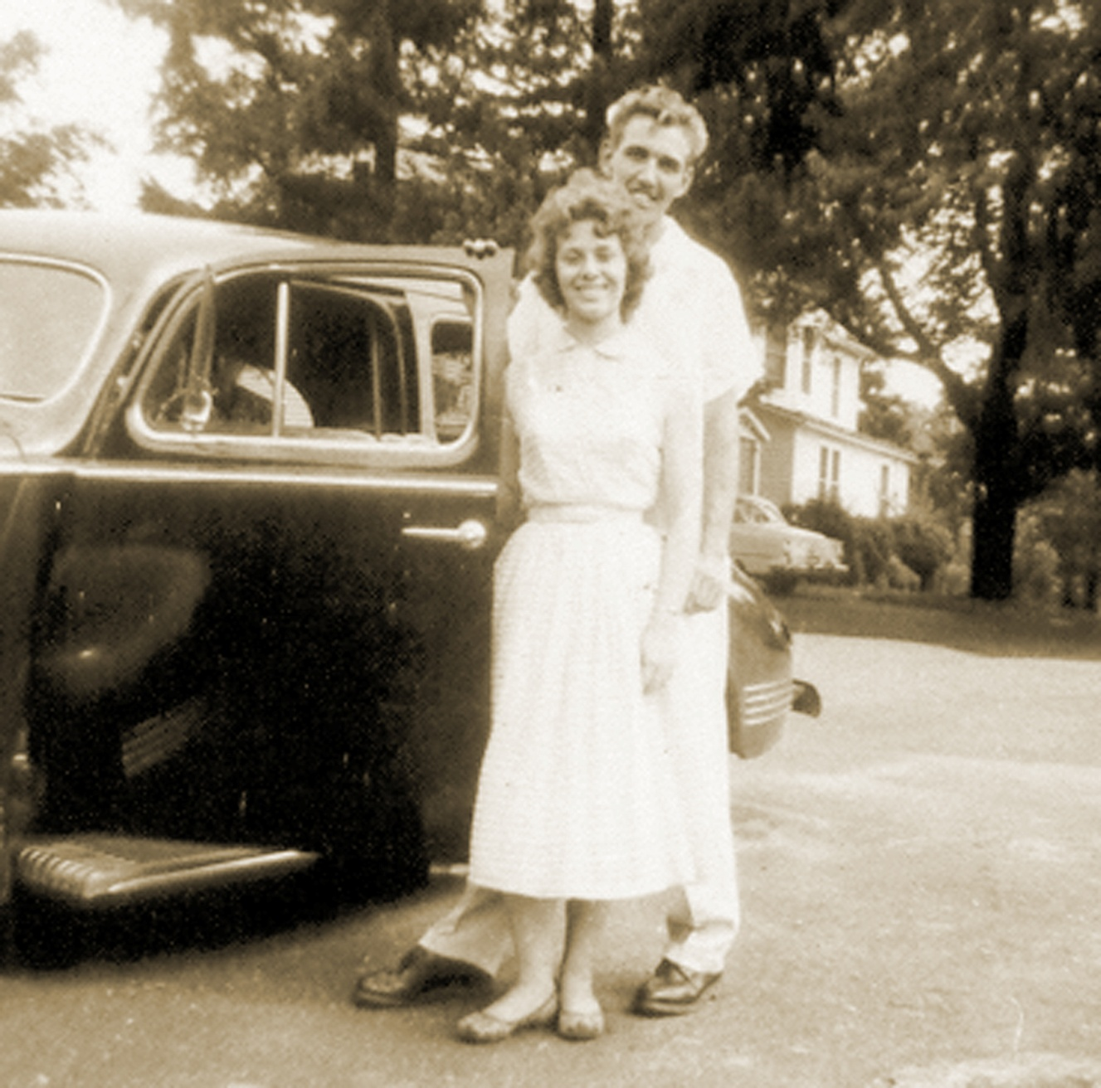

Slide 12
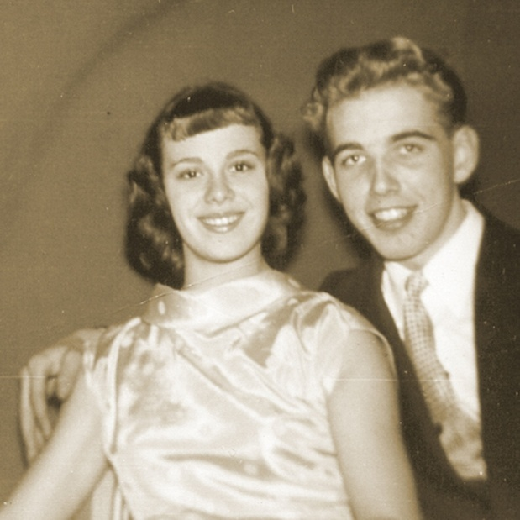
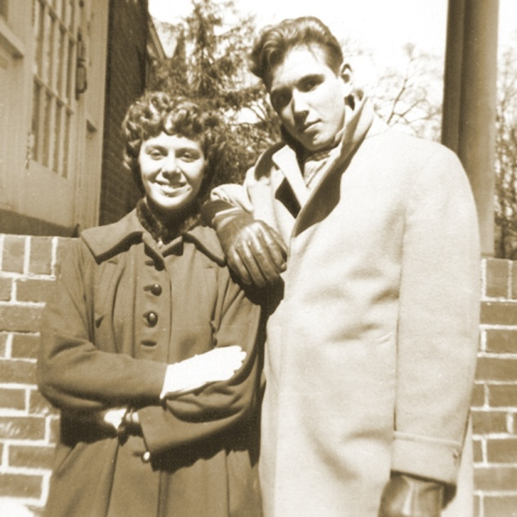
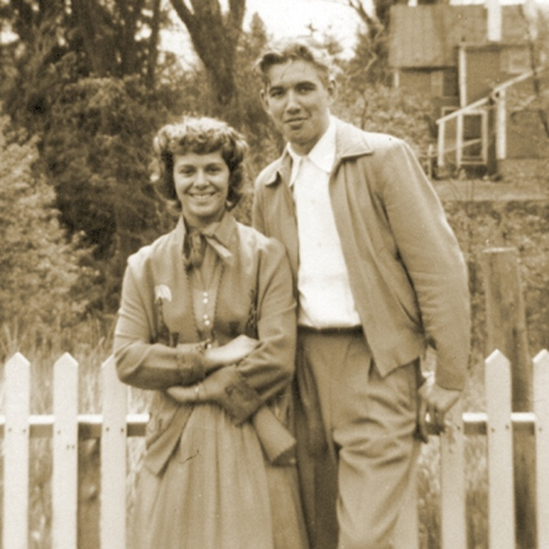
Dad & Mom
dating

Slide 13
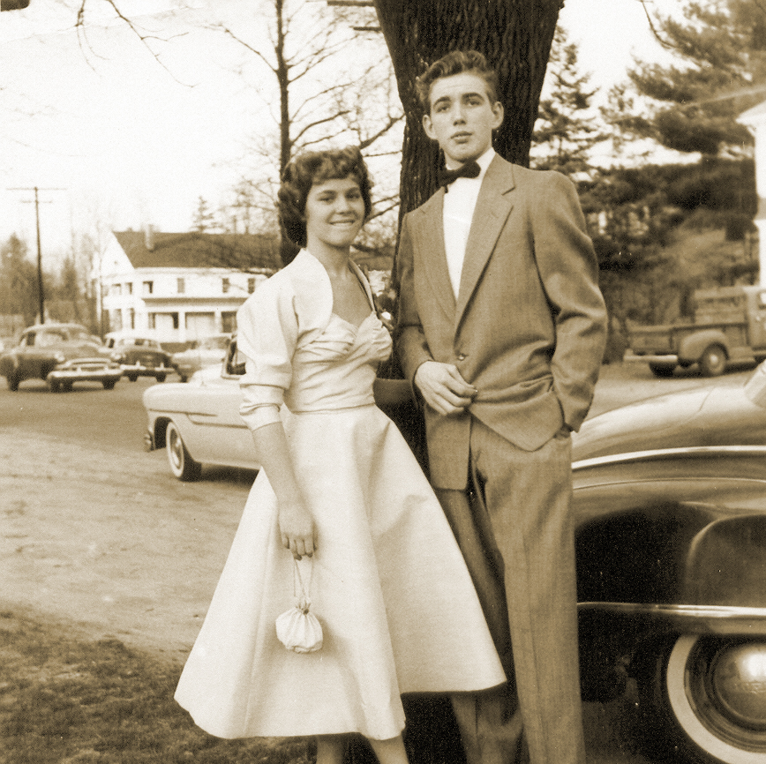

Slide 14
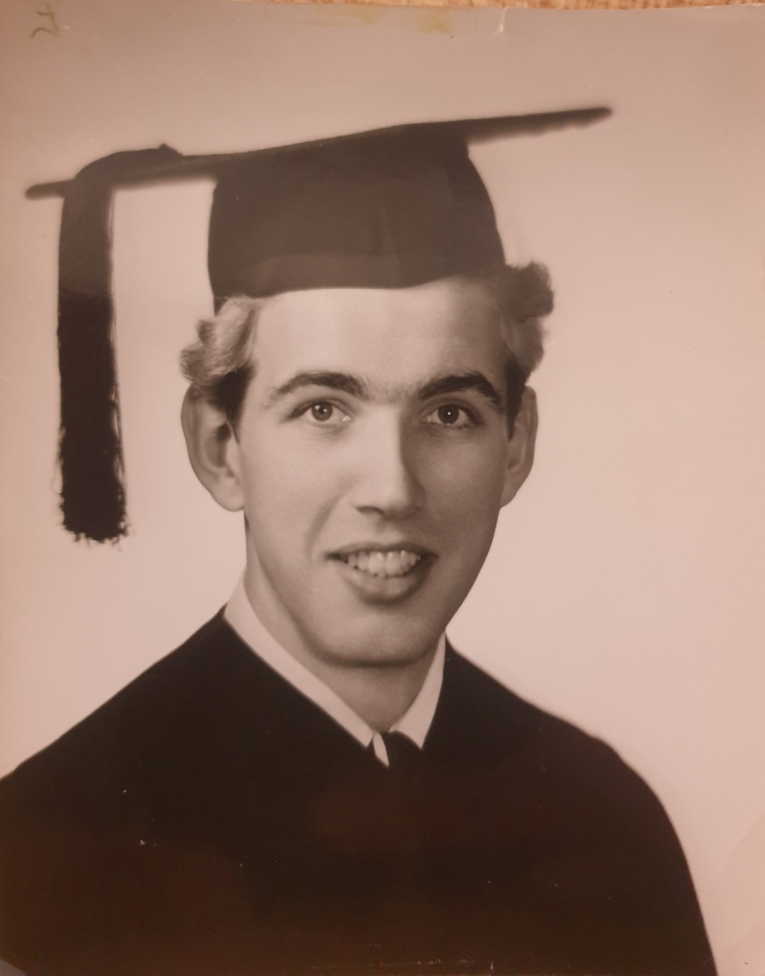
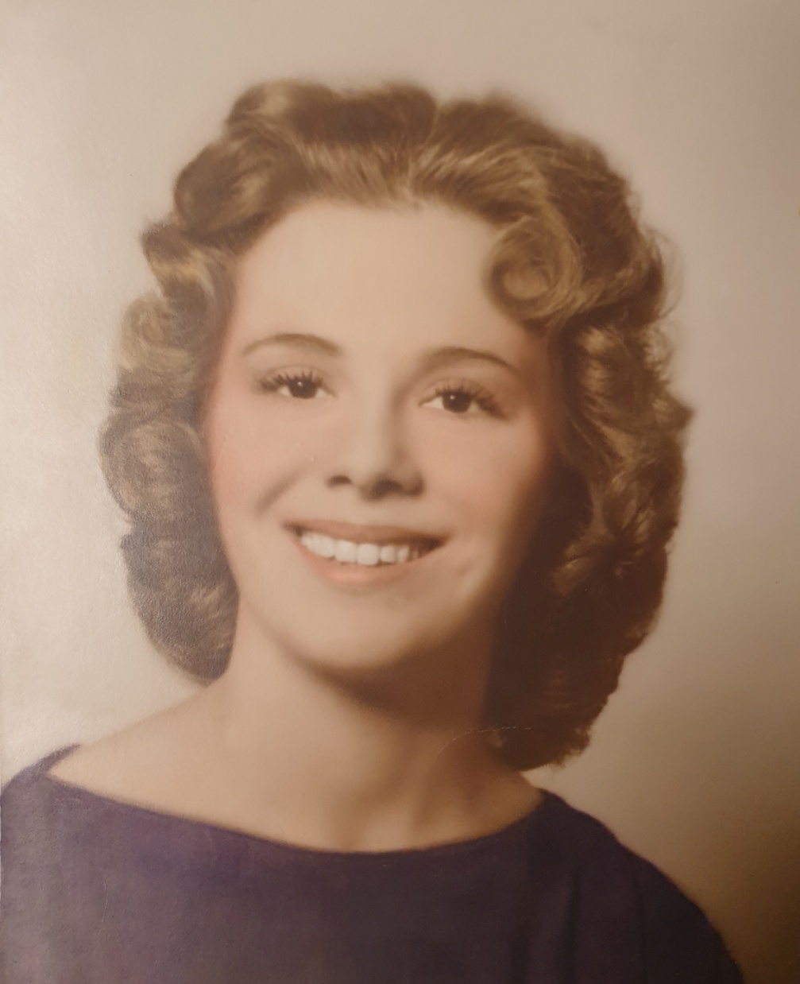

Slide 15
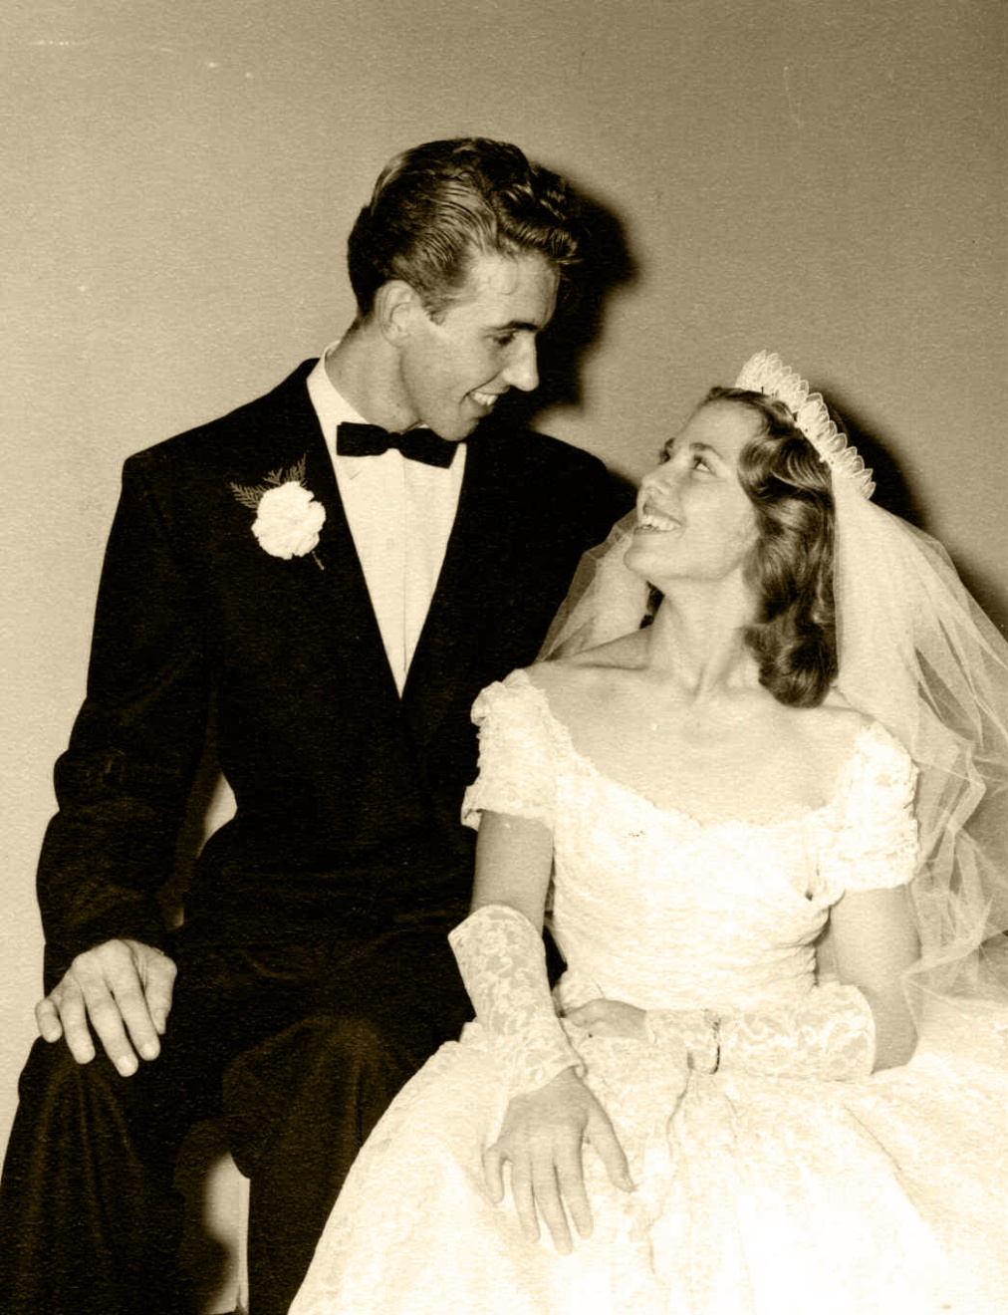
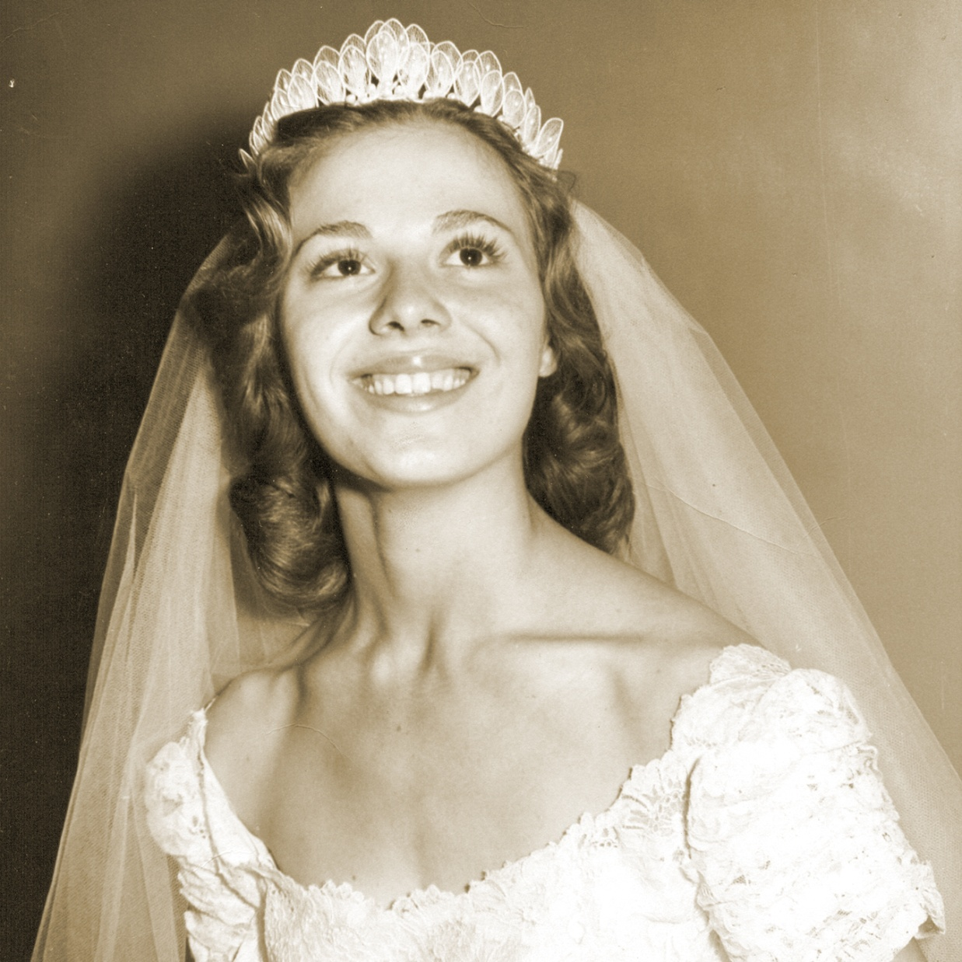

Slide 16
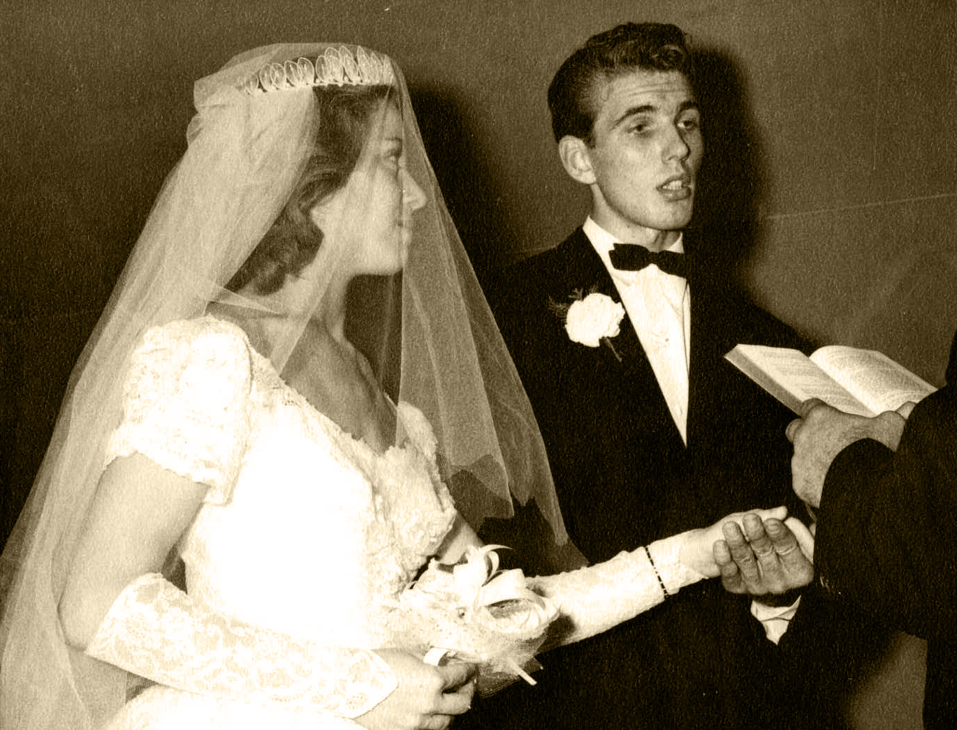

Slide 17
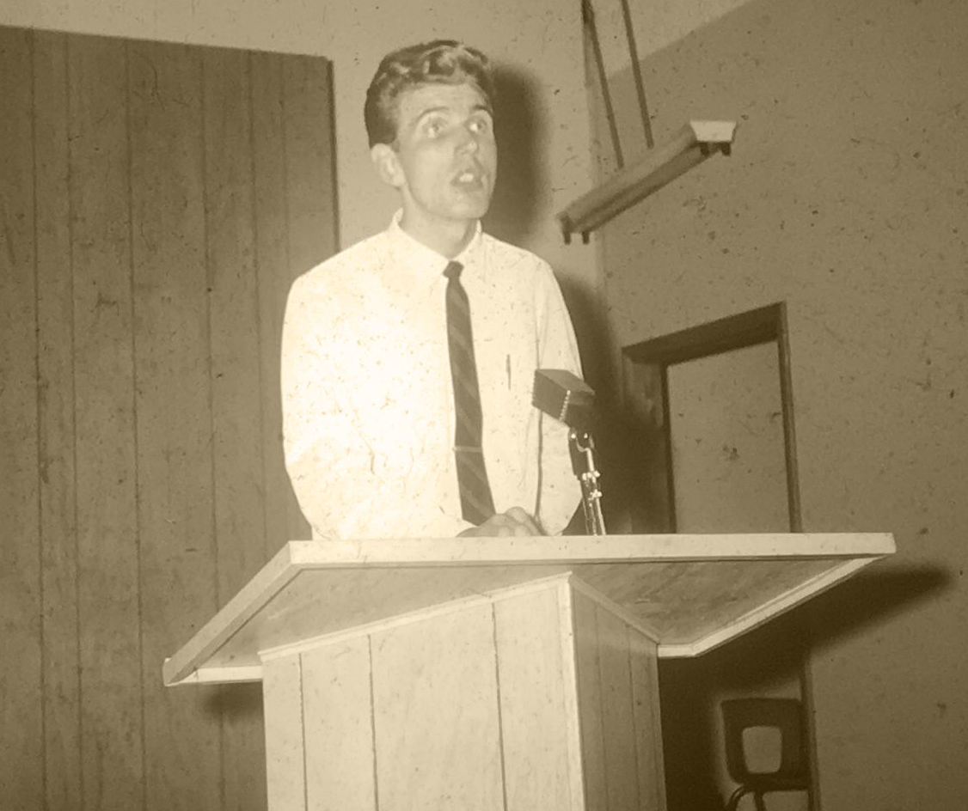
Dad giving
a health talk

Slide 18
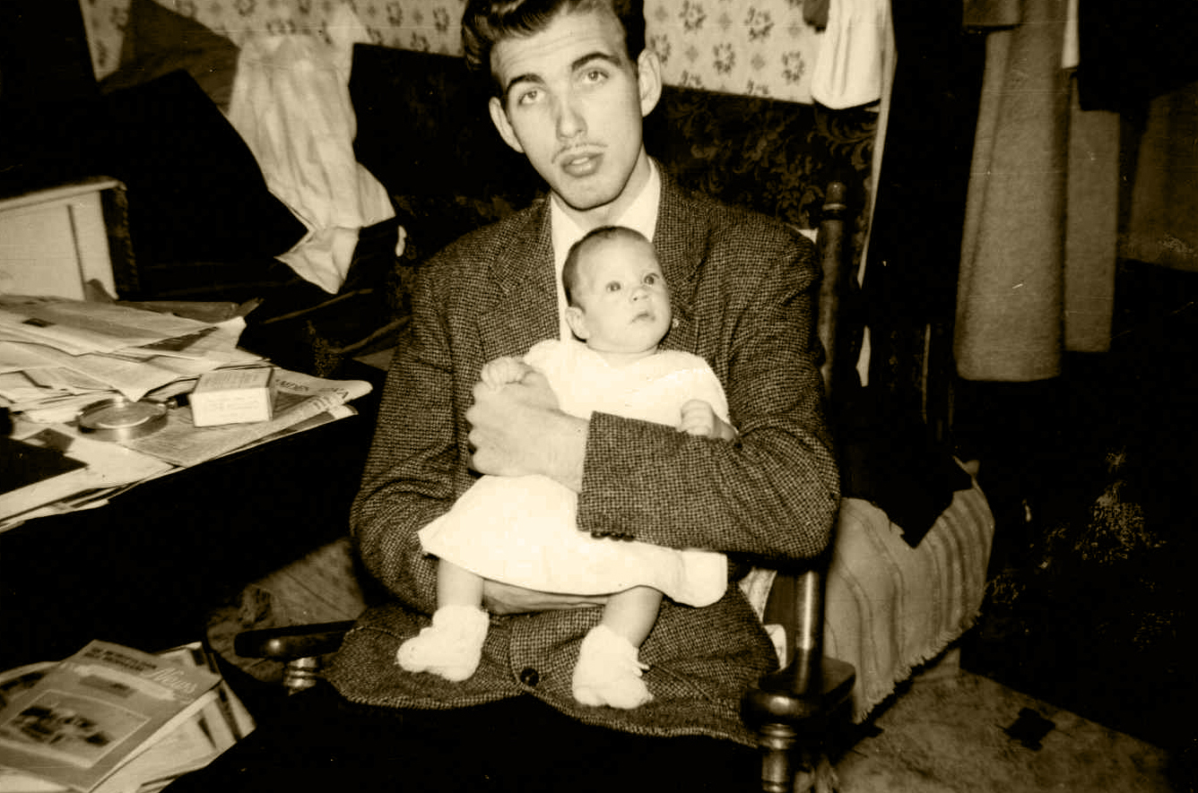
First baby

Slide 19
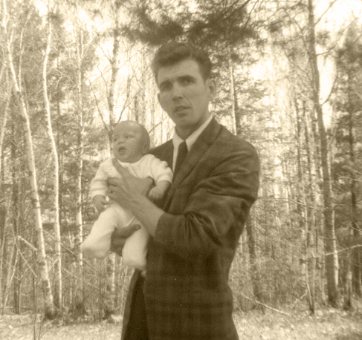
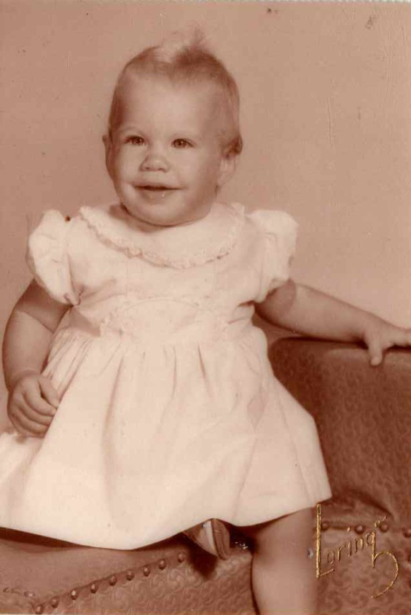
Dad and his first child, Melissa

Slide 20
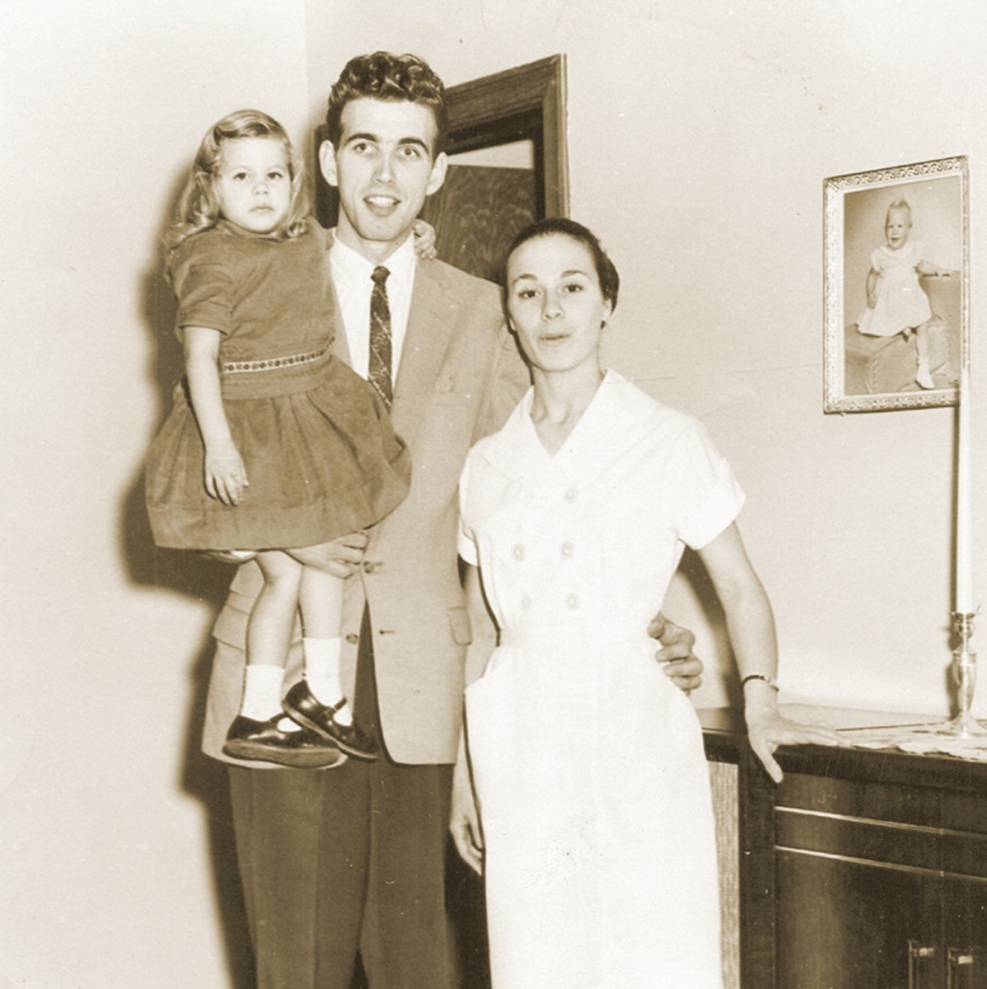
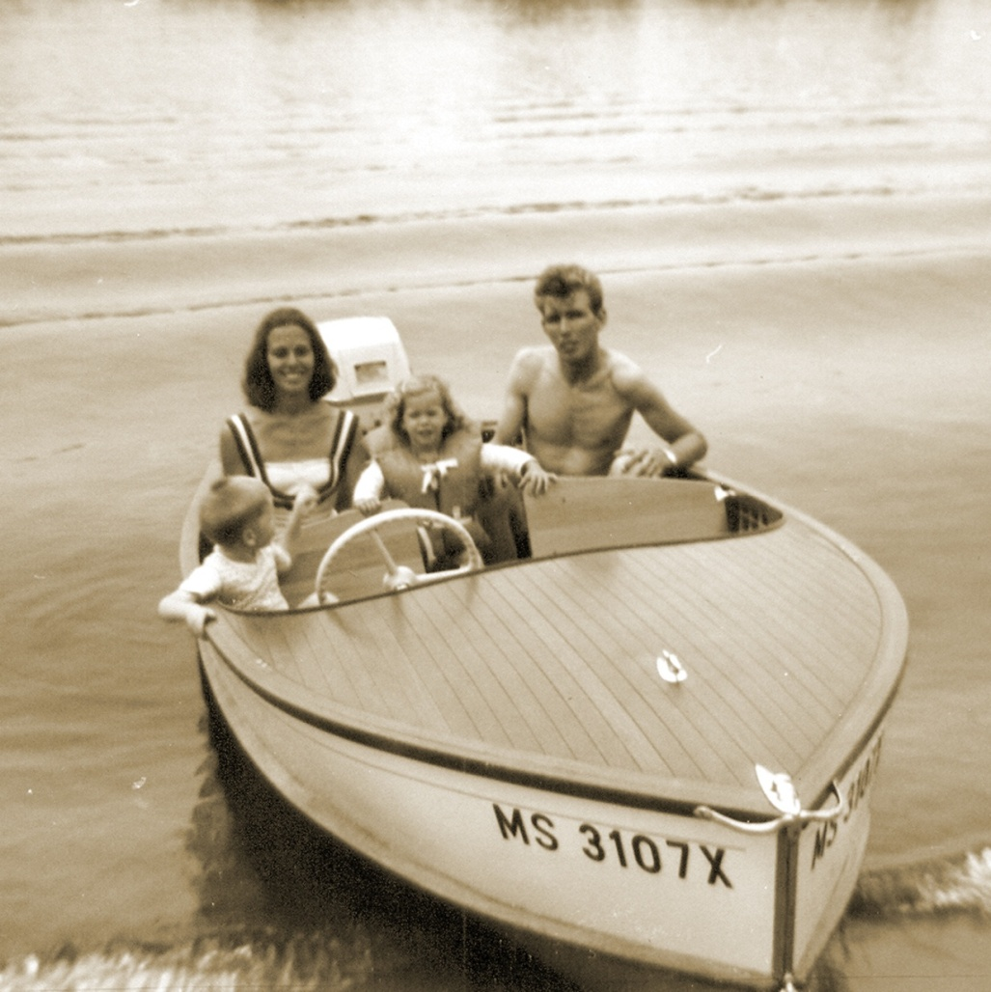

Slide 21
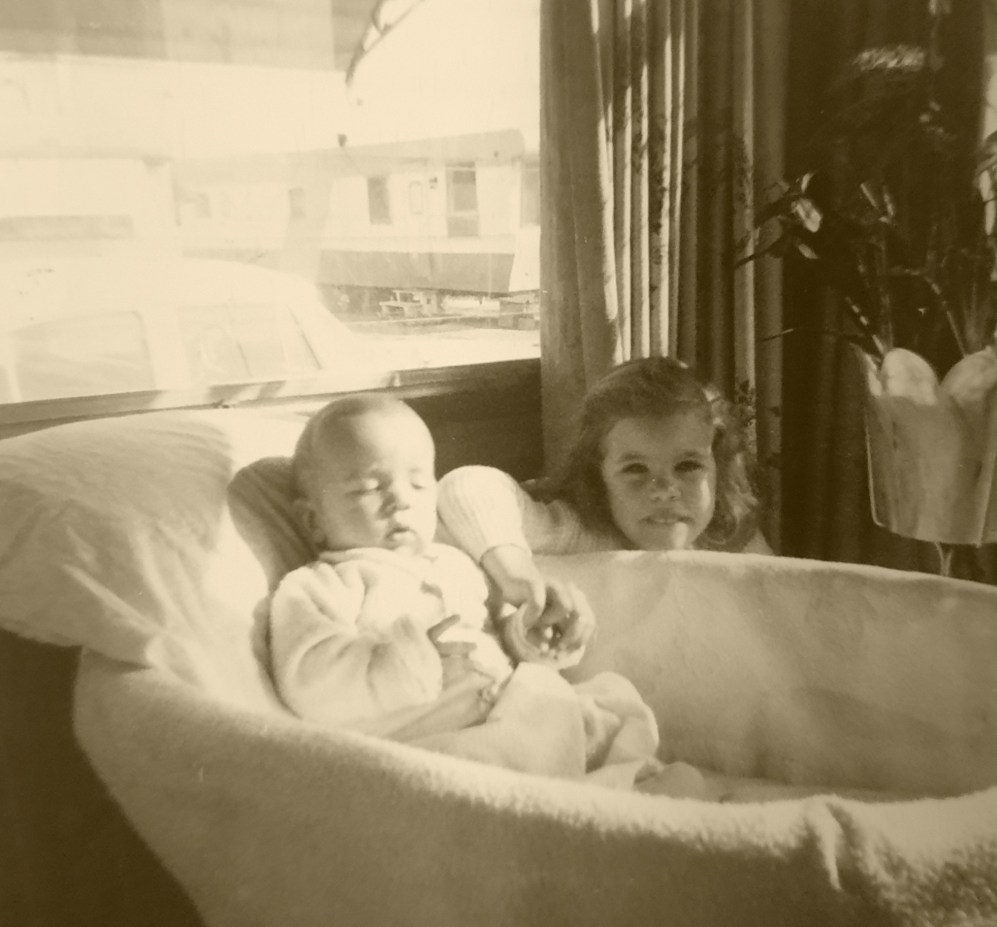
2nd child: John
2nd child: John

Slide 22
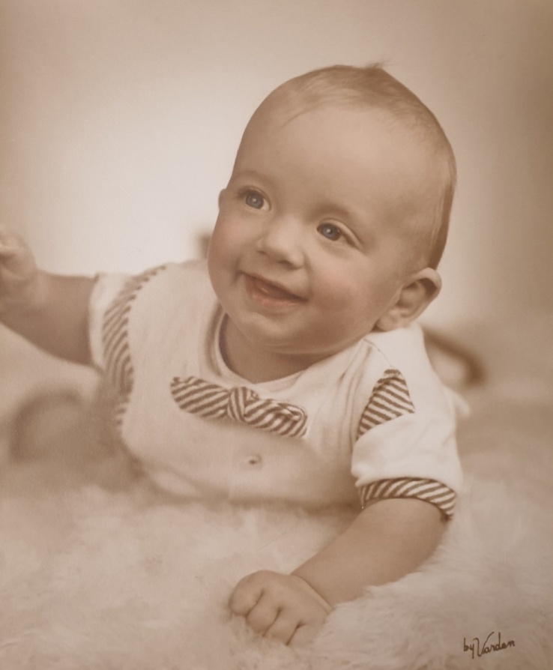
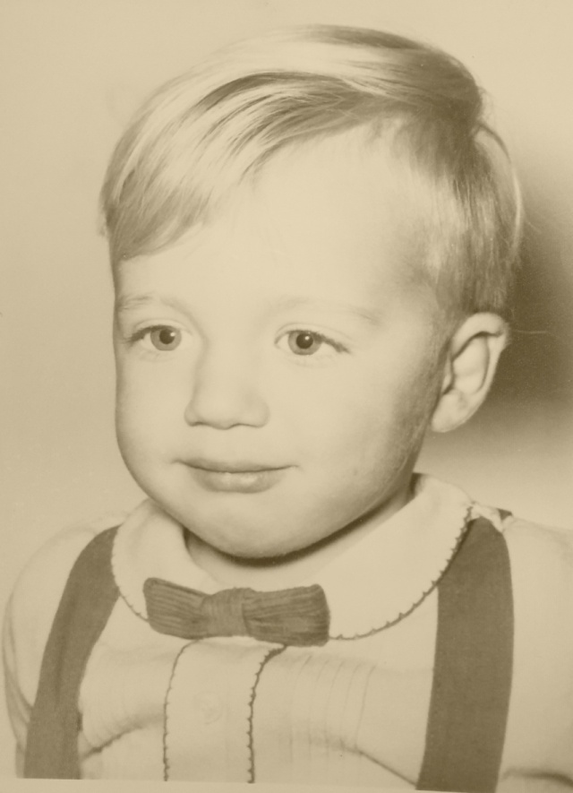
Dad’s first son: John

Slide 23
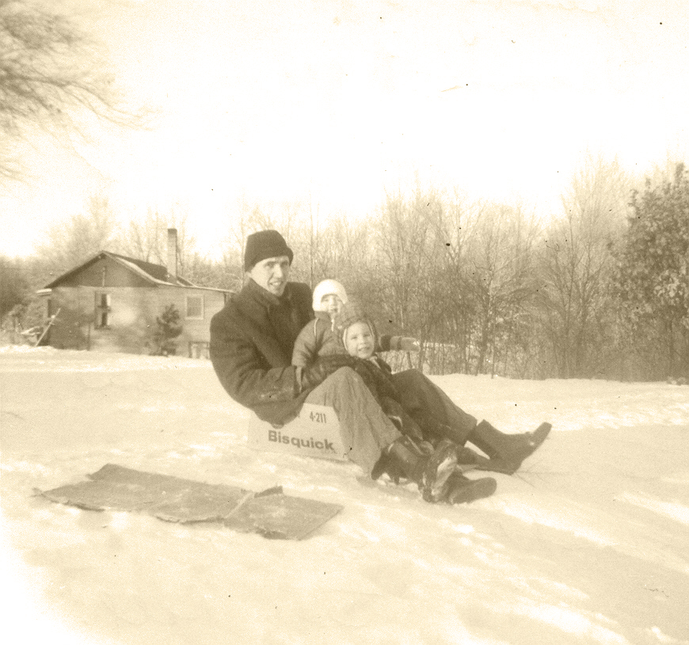
Cardboard boxes make great sleds

Slide 24
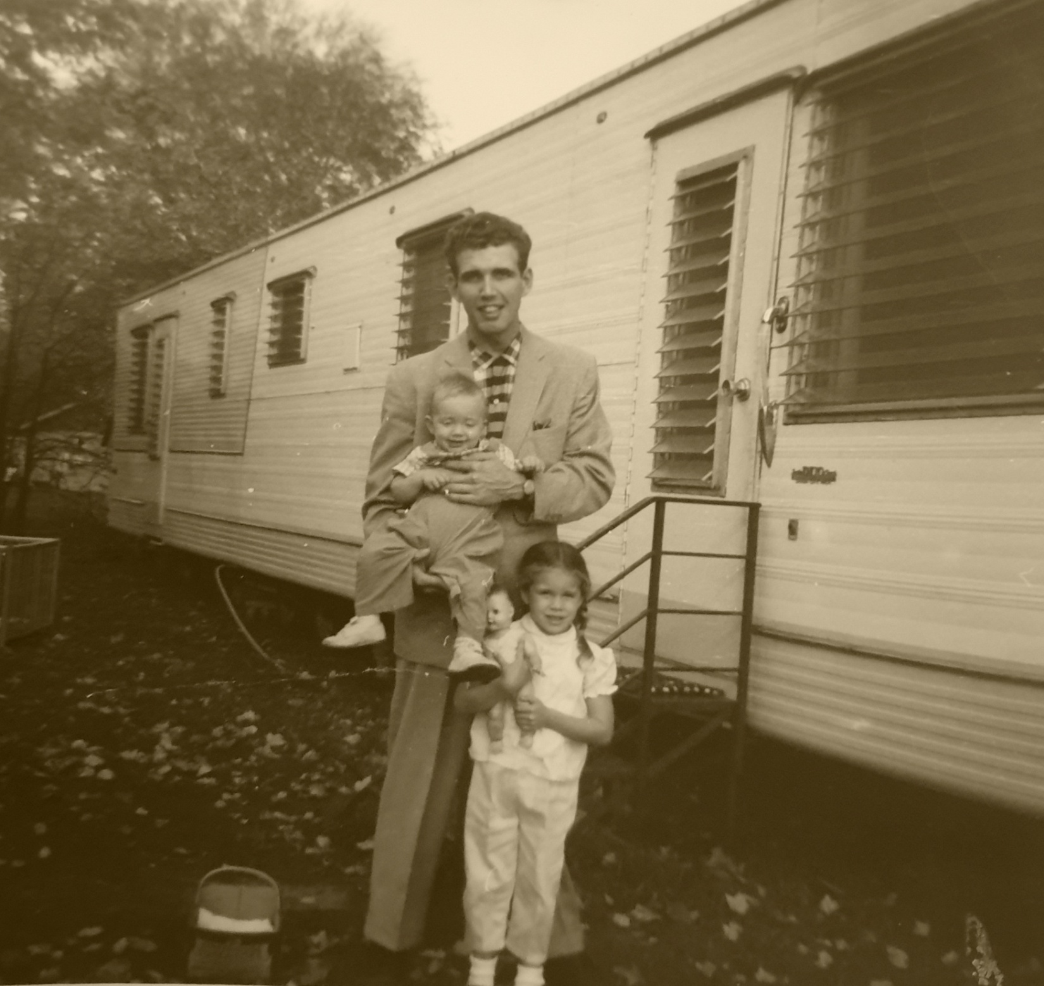

Slide 25
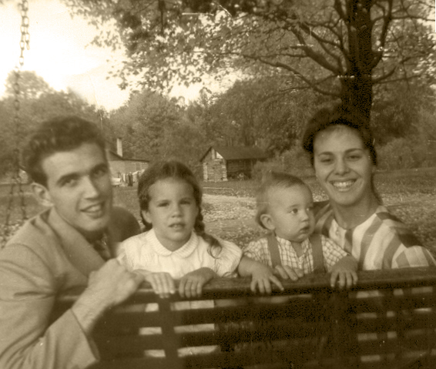

Slide 26
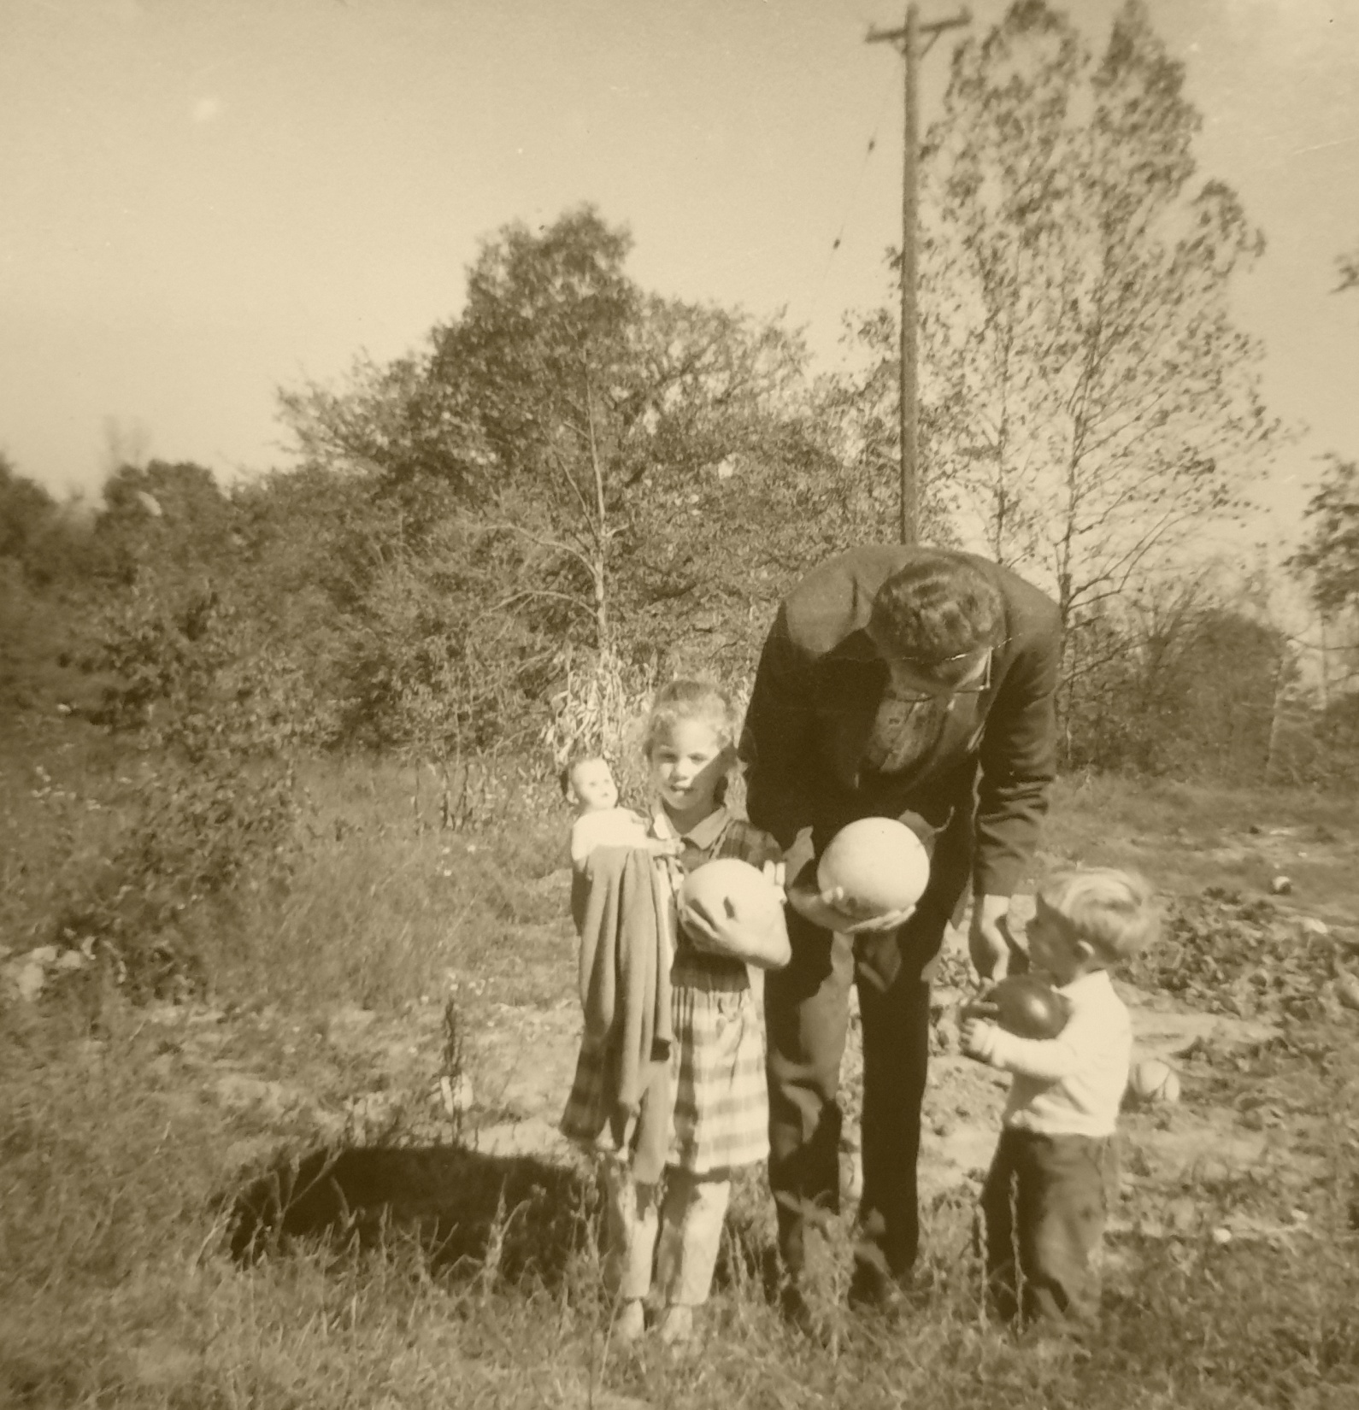
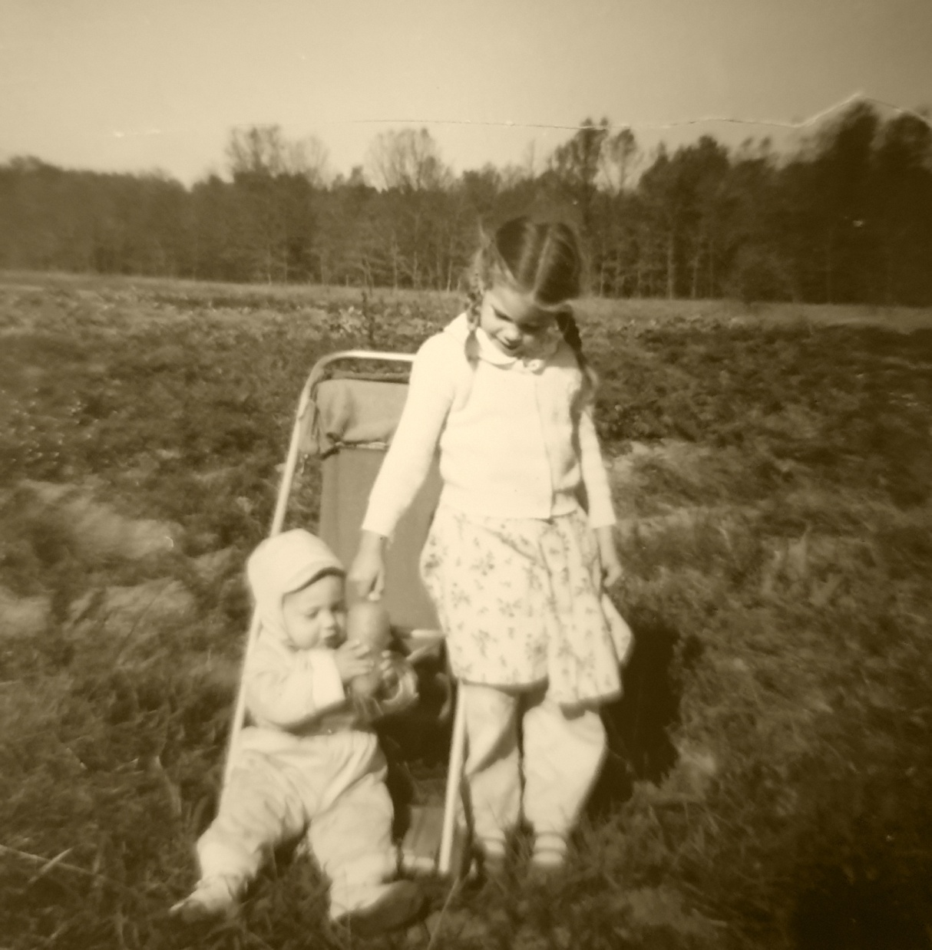

Slide 27
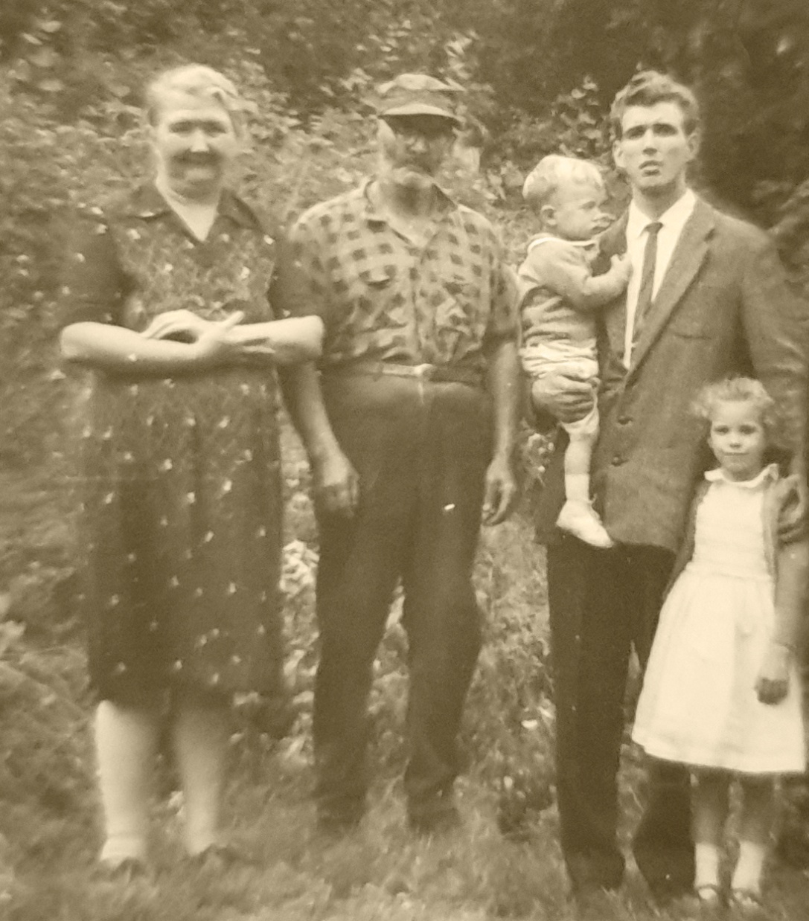
Dad’s mom, dad, and his first 2 children

Slide 28
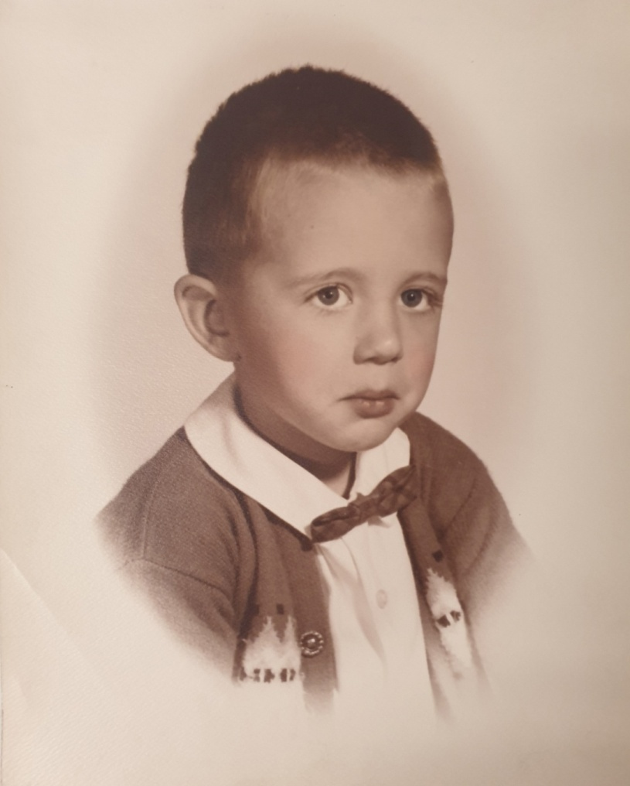
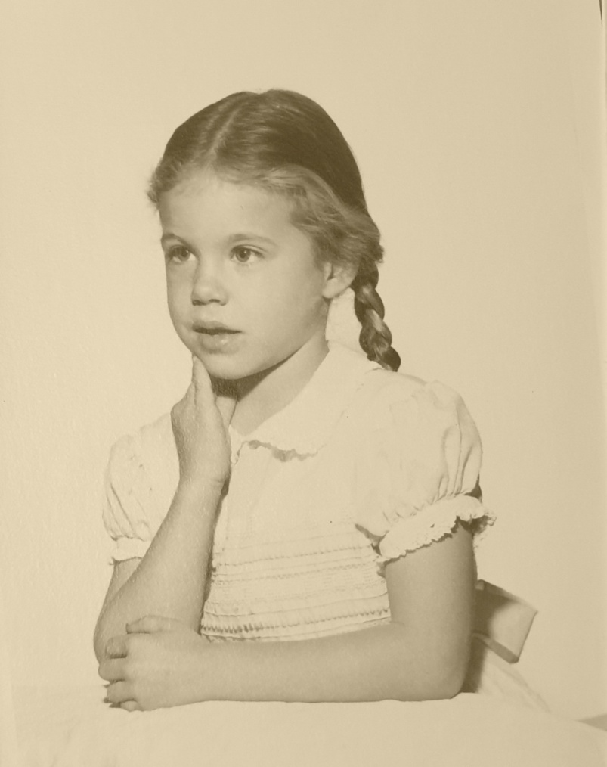
Dad’s first two children; John & Melissa

Slide 29
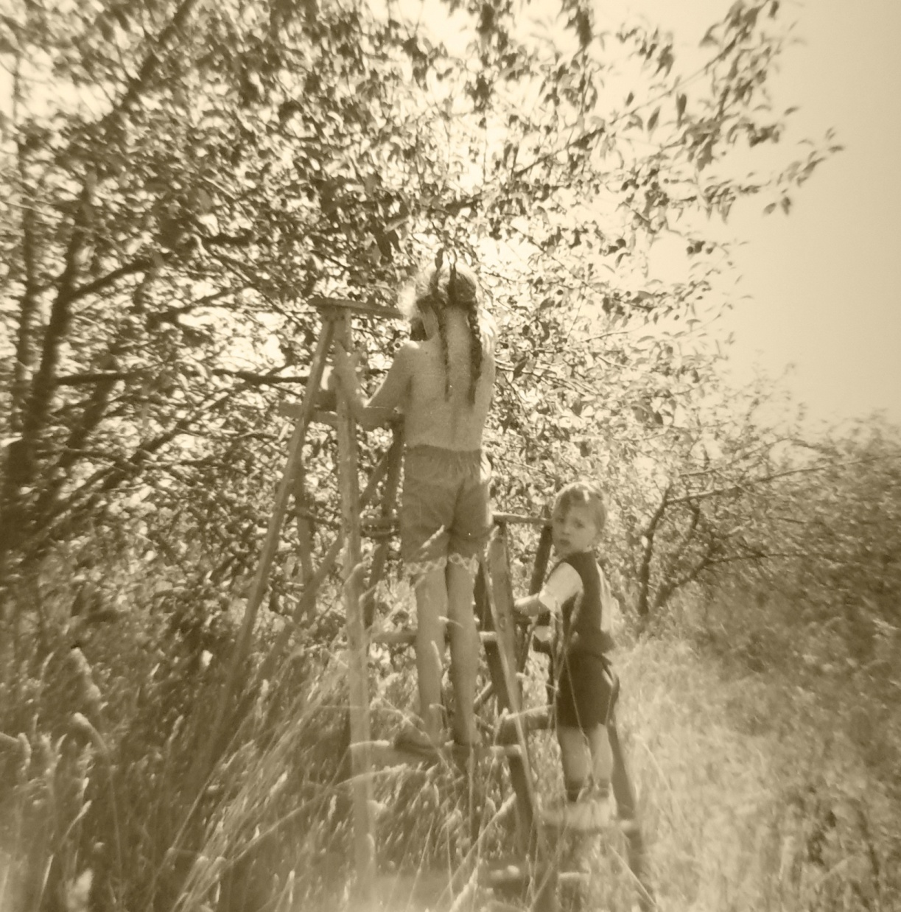
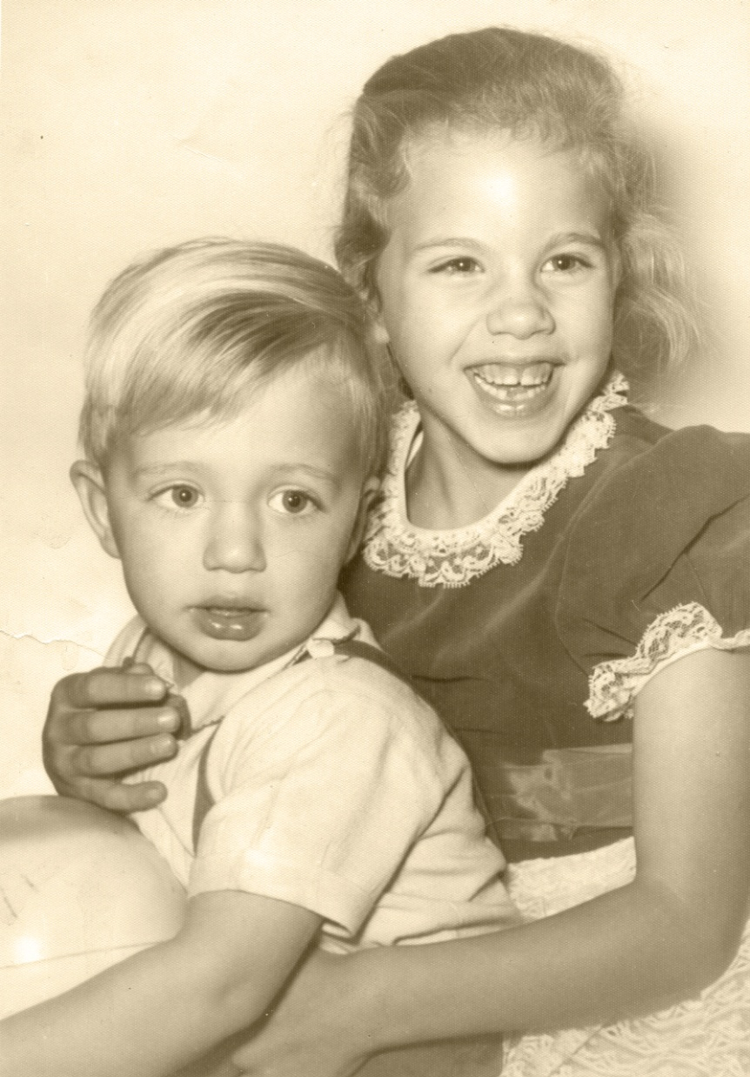

Slide 30
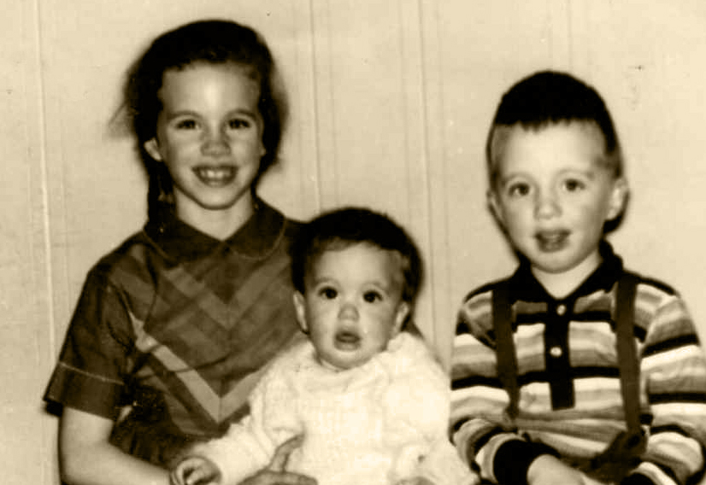

Slide 31
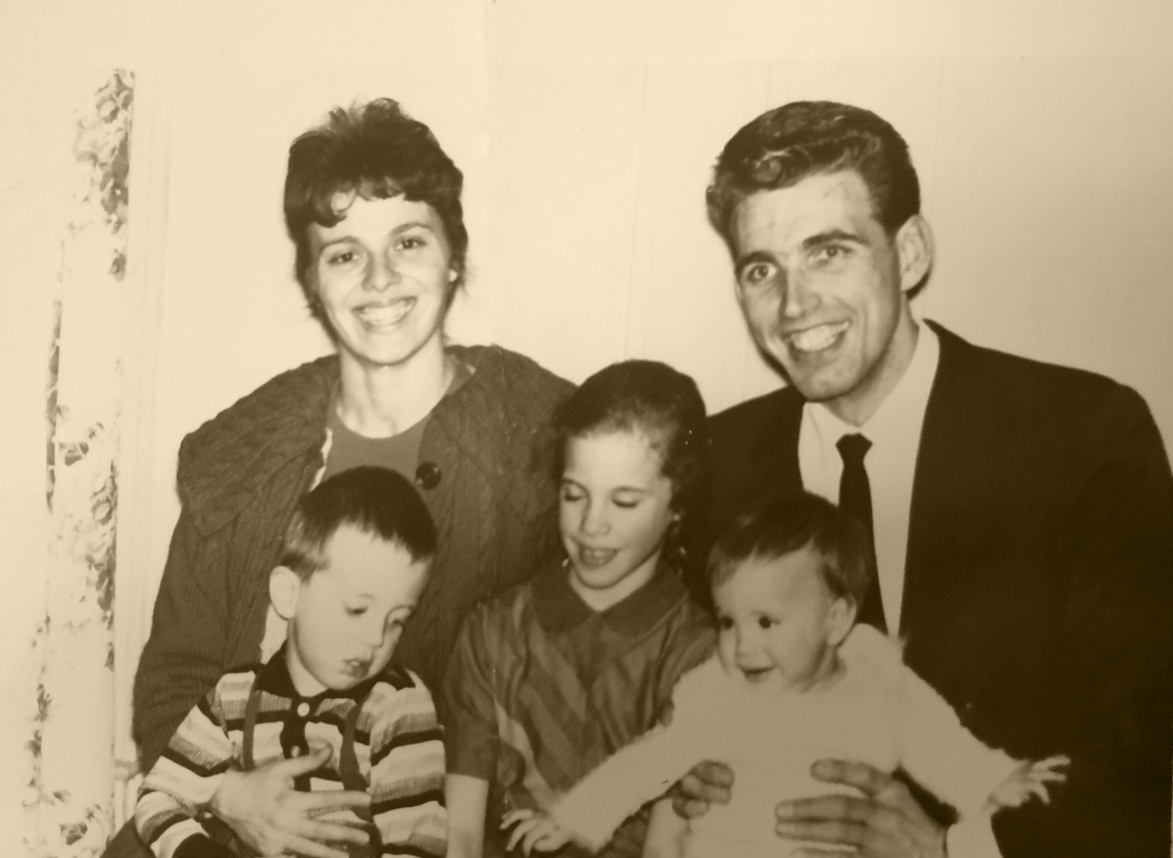

Slide 32
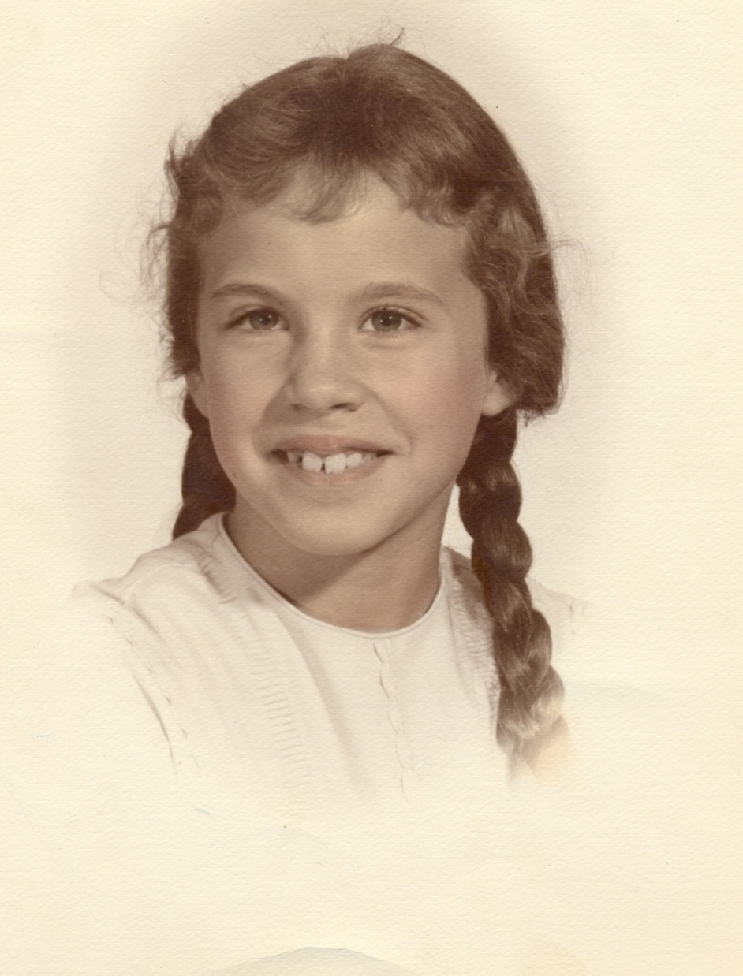
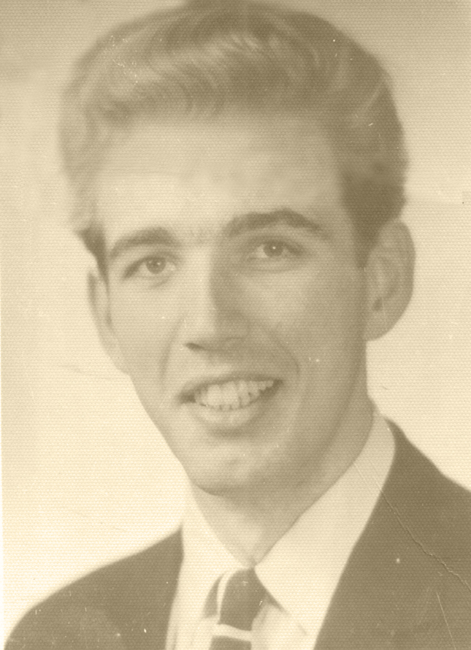
Daddy’s girl

Slide 33
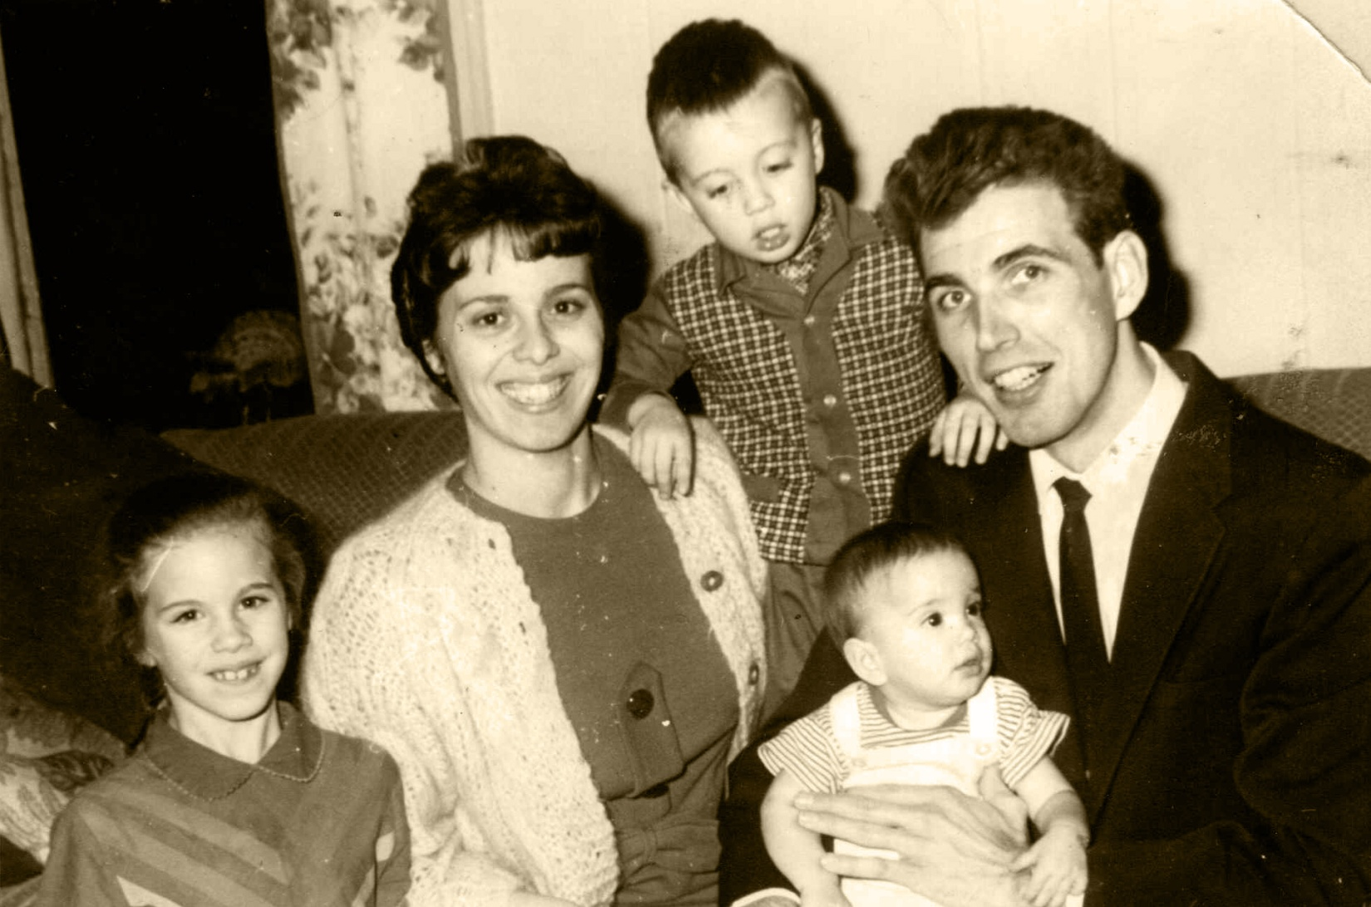

Slide 34
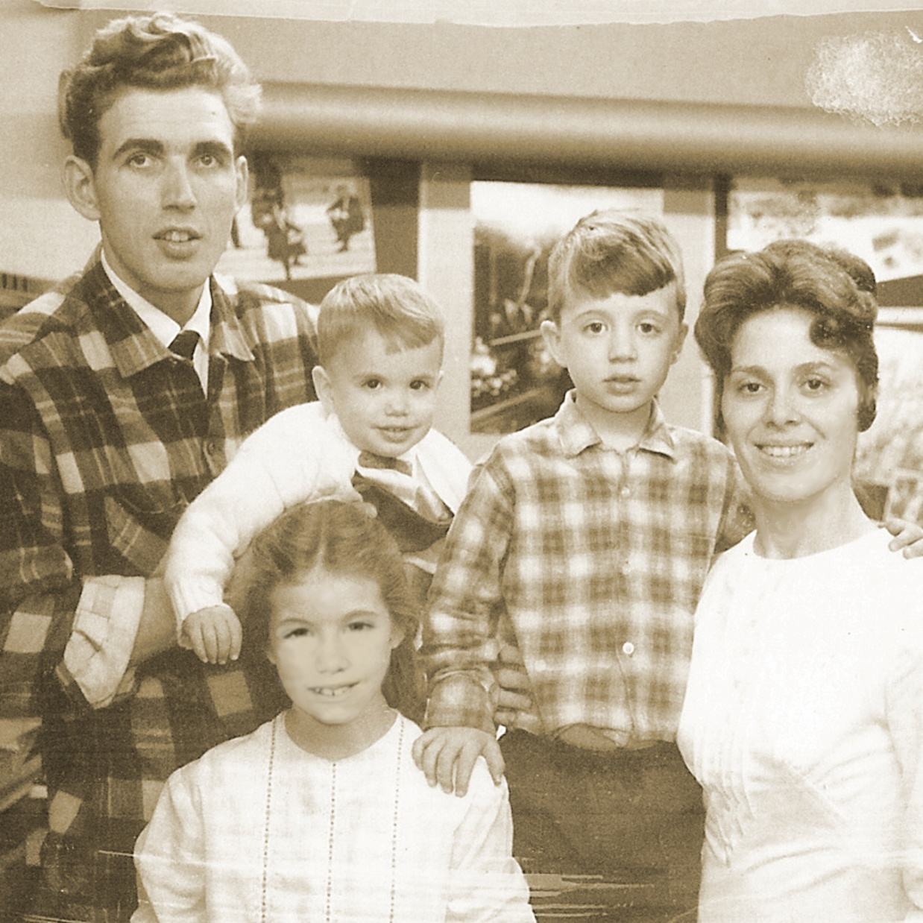

Slide 35
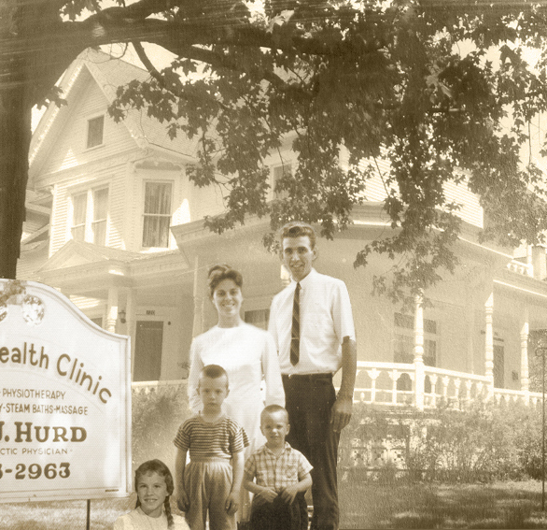
Health clinic in Michigan; living quarters upstairs

Slide 36
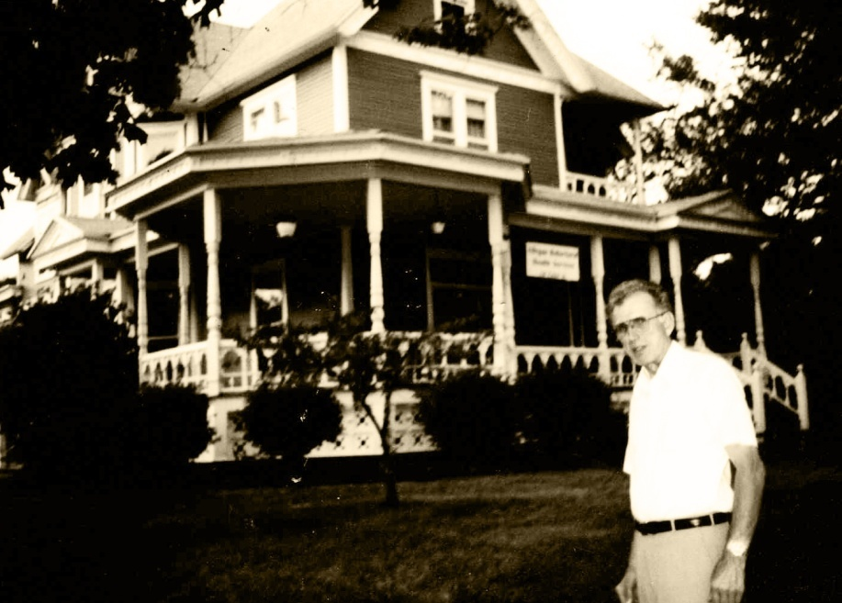
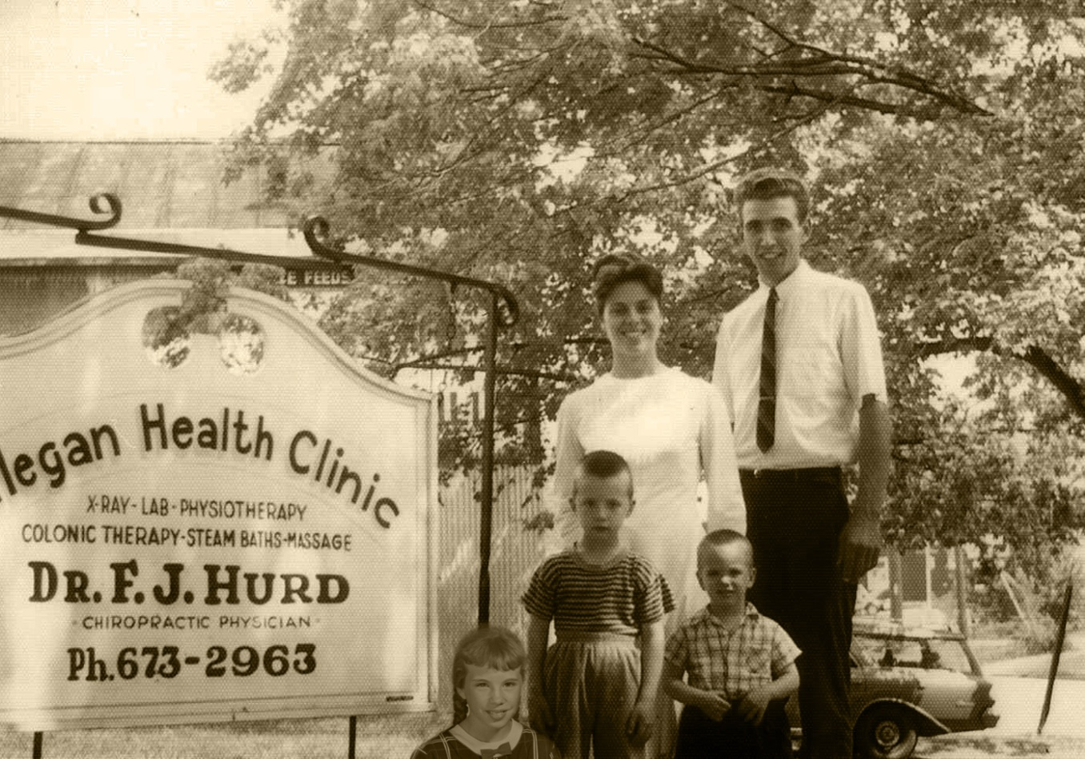
Allegan Health Clinic
X-ray, Lab, Physiotherapy,
Colonic Therapy,
Steam Baths, Massage

Slide 37
Pioneering health work and training school in Minnesota
Cabins moved in
Main house
Office building being moved in

Slide 38
Minnesota:
cabin renovated for natural food store

Slide 39
John working with the tractor

Slide 40
On tour doing health lectures and cooking schools

Slide 42
John, David, and new baby brother Enoch

Slide 43
Baby Esther and Enoch with kitties

Slide 44
Dad with Enoch, Esther, and David
How’d the chicken get in the house?

Slide 46
Esther and Enoch

Slide 50
Dad with Esther and Enoch

Slide 51
Dad with his boys: Enoch,
David,
& John

Slide 52
First grandkids: Benjamin and Jared

Slide 53
Dad with grandson Benjamin
Esther with Benjamin and Jared

Slide 54
Grandsons Benjamin and Jared

Slide 55
Esther and Enoch

Slide 56
Esther graduates

Slide 57
Dad, David, and Enoch

Slide 58
Grandsons Benjamin and Jared

Slide 59
Dad with
Granddaughter Laura

Slide 60
Dad with
grand-
daughter
Laura

Slide 61
Dad’s
grand-daughter
Laura

Slide 62
Dad with
granddaughter
Laura

Slide 63
Dad with
granddaughter
Laura
Graduating from
Milo Academy

Slide 66
Vacation

Slide 67
Dad and his girls, Esther and Melissa

Slide 68
Seeing patients in his office

Slide 69
Dad walks Esther up the aisle

Slide 71
Les
and
Melissa

Slide 72
Melissa & Les
get married

Slide 73
Melissa & Les

Slide 75
Dad & Mom’s 50th Wedding Anniversary

Slide 79
Dad & Mom with David, Les & Melissa
Esther, John, Melissa

Slide 80
Dad loved to pick berries

Slide 81
Dad with Mom, Enoch, and David

Slide 82
David

Slide 83
Dad with new grandbaby, Eden

Slide 84
Esther with Eden and River

Slide 85
Dad, Mom, River, Esther, Eden
Ross, River, Esther, Eden

Slide 87
Grandson Ben and marriage to Angela

Slide 88
Grandson
Ben & family
Great-grandson Grey
Great-grandson Ryder

Slide 89
Grandson Jared wedding to Christina

Slide 90
Grandson Jared & Christina
& great-grandson Jaxon

Slide 91
Grandson Jared, Christina, & great grandchildren
Jaxon & Carrigan

Slide 92
Great grandchildren Carrigan & Jaxon

Slide 93
Dad & Mom, great-grand-daughter Carrigan

Slide 95
David,
John,
Melissa

Slide 96
Dad with son-in-law Ross, sons David & Enoch, grandkids River & Eden

Slide 97
Dad with Mom, daughter Esther, grandkids River & Eden

Slide 98
Grand-daughter Eden and grandson River

Slide 99
Daughter Esther with grandkids
River and Eden

Slide 100
Grandkids River and Eden with their mom Esther

Slide 102
Granddaughter Laura

Slide 103
Laura & Trevor

Slide 106
Melissa,
David,
Esther

Slide 107
Enoch, Kelsey & Rylee
Granddaughter Kelsey

Slide 108
Granddaughters Rylee
and Kelsey (far right)

Slide 109
Son Enoch,
Granddaughter Kelsey

Slide 110
Granddaughter Rylee

Slide 111
Granddaughters Kelsey and Rylee

Slide 113
Dad and Melissa

Slide 114
Dad & Mom with children Esther, Melissa, Enoch, & David

Slide 115
Dad and his brother Chuck

Slide 120
Dad & Mom’s re-baptism

Slide 123
Last pictures of dad before his fall

Slide 125
Until we meet again!!

